Slide 1
Computer
By shivam

Slide 2
A computer is a machine that can be programmed to automatically carry out sequences of arithmetic or logical operations. Modern digital electronic computers can perform generic sets of operations known as programs. These programs enable computers to perform a wide range of tasks.
WHAT IS COMPUTER?

Slide 3
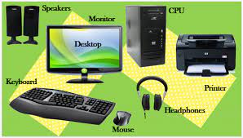
Parts of computer

Slide 4
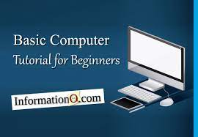
What is basic computer?
The Basics of Computer and its Basic Operations is an important topic. Computer is Electronic Device that receives input from the user, calculates, processes the raw data into meaningful information and provides the desired results as output. Basically, it has the capability to transform Data.

Slide 5
What is mainframe computer?
A mainframe computer, informally called a mainframe or big iron, is a computer used primarily by large organizations for critical applications like bulk data processing for tasks such as censuses, industry and consumer statistics, enterprise resource planning, and large-scale transaction processing.

Slide 6
TYPES OF COMPUTER
There are many different types of computers, but here are 7 of the most common computer: supercomputers, mainframe computers, minicomputers, personal computers (pcs), workstation computers, microcontrollers & smartphones.

Slide 7
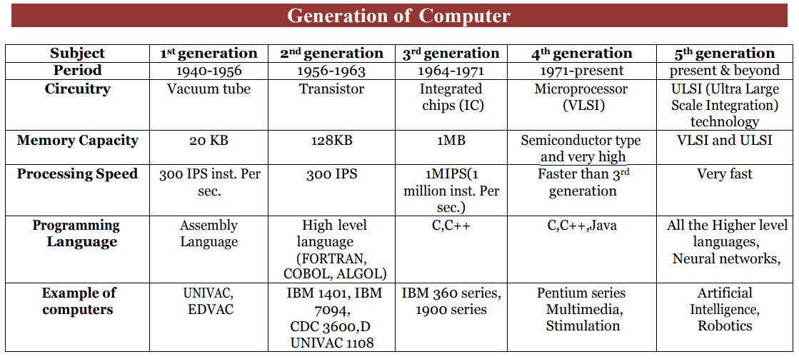
GENRATION OF COMPUTER
The generations of computers are typically divided into five distinct phases: First Generation (1940-1956): Vacuum Tubes. Second Generation (1956-1963): Transistors. Third Generation (1964-1971): Integrated Circuits. Fourth Generation (1971-Present): Microprocessors.

